Slide 1
SOCIAL JUSTICE
justice in terms of the distribution of wealth, opportunities, and privileges within a society.
"individuality gives way to the struggle for social justice"

Slide 2
HISTORY AND PHILOSOPHY OF JUSTICE

Slide 3
PERSPECTIVES OF DISTRIBUTIVE JUSTICE
Utilitarian (J.S Mill, 1963)
Egalitarian (John Rawls, 1971)
Libertarian (Nozick, 1974; Sen 2009)

Slide 4
BENTHAM’S FORMULATION OF UTILITARIANISM
Man is under two great masters, pain and pleasure.
The great good that we should seek is happiness. (a hedonistic perspective)
Those actions whose results increase happiness or diminish pain are good. They have “utility.

Slide 5
4 TYPES OF UTILITARIANISM
Consequentialism: The rightness of actions is determined solely by their consequences.
Hedonism: Utility is the degree to which an act produces pleasure. Hedonism is the thesis that pleasure or happiness is the good that we seek and that we should seek.
Maximalism: A right action produces the greatest good consequences and the least bad.
Universalism: The consequences to be considered are those of everyone affected, and everyone equally

Slide 6
2 FORMULATIONS OF UTILITARIANISM
Principle of Utility:
The best action is that which produces the greatest happiness and/or reduces pain.
Greatest Happiness:
We ought to do that which produces the greatest happiness and least pain for the greatest number of people.

Slide 7
2 TYPES OF UTILITARIANISM
Act: An Action is right if and only if it produces the greatest balance of pleasure over pain for the greatest number.
(Jeremy Bentham)
Rule: An action is right if and only if it conforms to a set of rules the general acceptance of which would produce the greatest balance of pleasure over pain for the greatest number. (John Stuart Mill)

Slide 8
JOHN STUART MILL’S ADJUSTMENTS TO UTILITARIANISM
Mill argues that we must consider the quality of the happiness, not merely the quantity.
For example, some might find happiness with a pitcher of beer and a pizza. Others may find happiness watching a fine Shakespearean play. The quality of happiness is greater with the latter.

Slide 9

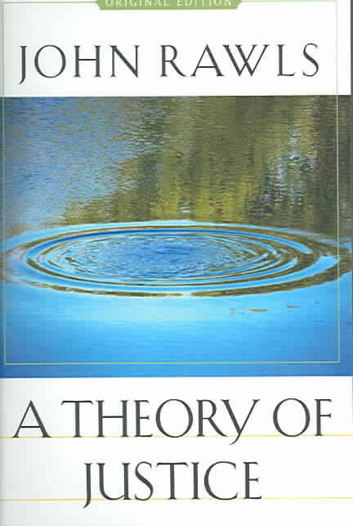
“Justice as fairness” was proposed by John Rawls in his book “A theory of Justice” (1971).
Wellbeing of the people is largely dependent on the social system of cooperation, without which worthy living is impossible.

Slide 10
RAWLS’ ….
“Institutions are just when no arbitrary distinctions are made between persons in the assigning of basic rights and duties and when the rules determine a proper balance between competing claims to the advantages of social life” (1999:5).
Society is a fair system of cooperation (reciprocity) between free and equal citizens. Thus citizens and institutions must cooperate to fulfill basic needs.

Slide 11
2 PRINCIPLES OF RAWLSIAN JUSTICE
Principle of equal basic liberty
A person should have the equal basic liberties compatible with similar scheme that holds to another person residing in the same society
Two moral powers:
Capacity for a sense of justice which is the capacity to understand, to apply and to act;
Capacity for a conception of good which is the capacity to have, to revise and to rationally pursue

Slide 12
2 PRINCIPLES OF RAWLSIAN JUSTICE
Principle of fair equality of opportunity and difference
Fair equality of opportunity guarantees fair access for all citizens with equal ability and talent irrespective of their socio-economic background
Emphasizes on incorporation of free market system within political and legal institutions to prevent excessive concentration of wealth and opportunity to a particular group
More emphasis on education. Recommends for fair amount of budget for education who are economically disadvantaged but not obligatory

Slide 13
2 PRINCIPLES OF RAWLSIAN JUSTICE
Three groups can claim:
People who cooperate with the economy and work but fail to make a living wage;
People who are unable to work because of ill health;
People who remain unemployed due to the seasonal or temporary nature of jobs
They will receive an amount pegged to the “social minimum”.

Slide 14
2 PRINCIPLES OF RAWLS….
Difference principle recognizes economic and social inequality to some extent if it fulfills the greatest interest of the least advantaged
Least advantaged will be identified based on five primary goods:
Basic rights and liberties;
Freedom of movement and free choice of occupation;
Power and prerogatives of offices;
Positions of authority and responsibility;
Income wealth and social bases of respect

Slide 15
“All these primary goods are to be distributed equally unless an unequal distribution of any, or all, of these values is to everyone’s advantage” (1999, p. 54).
a ratio of shares would be created on the basis of citizens’ “appropriate contributions . . . to the good of others by training and educating their native endowments and putting them to work within a fair system of cooperation”.
Citizen’s index of primary goods could be low, medium, or high based on the market value of their contributions.
It emphasizes on incentive for work and productivity.

Slide 16
CAPABILITY AND SOCIAL JUSTICE (SEN, 2009, THE IDEA OF JUSTICE)
‘A just society is one where people are free to be and to do what is valuable to them. It focuses on the opportunity of functioning of the individual’.
Key elements of Sen’s Approach
Freedoms: the person is able to choose from a set of possible alternatives (the more the opportunities, the more opportunities for functioning and choices)
Functioning/Achievement: beings and doings (fed, clothed, literate…to …being able to appear in public)/ actual functioning
Agency and Wellbeing: Responsible agents, commitments and obligations vs. self-wellbeing

Slide 17
CAPABILITY AND SOCIAL JUSTICE…
In showing the link between capability and wellbeing of a person, Sen focusses on 2 important issues; wellbeing freedom and agency freedom.
Wellbeing freedom: passive recipients of policies designed to remove inequalities and achieve better conditions for them
Agency freedom: To become active agents to promote and achieve social and political transformation
Limitation: Absence of lists, too individualistic, under specification and less comprehensive

Slide 18
CAPABILITY AND SOCIAL JUSTICE…..
Positive: individual and social context, social and market features, universality and diversity, social action and change
Use of Capability Approach
Capability for work: The issue of capability for work refers to ‘job quality’, the valuable work not only in terms of cash benefits but also conditions of work and benefits received.
Capability for Voice: The notion of capability for voice designates the extent to which people are allowed to express their wishes, expectations and concerns in collective decision making process.

Slide 19
REFERENCE
Islam, M. S. and Hossain, M. I (2016), Social Justice in Globalization of Production: Labour Gender and the Environmental Nexus. UK: Palgrave MacMillan

